Slide 1
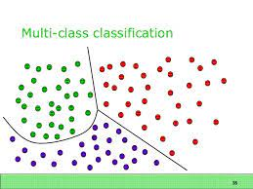
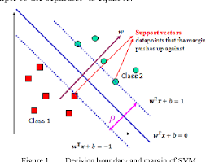
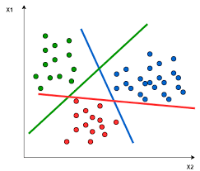
16CSE09 / Machine Learning Techniques
Unit - 4 / Session – 7
CO4: Model data classification using support vector machines
Topic: SVM with more than two classes

Slide 2
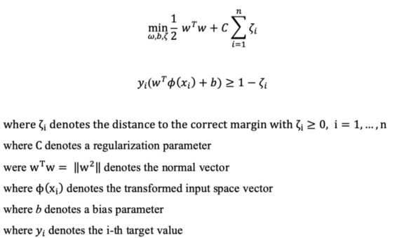
Mathematical Concept Behind SVM
The following formula poses the optimization problem that is tackled by SVMs.

Slide 3
SVM with more than two classes
How can we extend SVMs to the more general case where we have some arbitrary number of classes?
It turns out that the concept of separating hyperplanes upon which SVMs are based does not lend itself naturally to more than two classes.
Though a number of proposals for extending SVMs to the K-class case have been made, the two most popular are the one-versus-one and one-versus-all approaches.

Slide 4

SVM with more than two classes
One-Versus-One Classification: Suppose that we would like to perform classification using SVMs, and there are K > 2 classes. A one-versus-one or all-pairs approach constructs SVMs, each of which compares a pair of classes.
For example, one such SVM might compare the kth class, coded as +1, to the k’th class, coded as −1.
We classify a test observation using each of the classifiers, and we tally the number of times that the test observation is assigned to each of the K classes. The final classification is performed by assigning the test observation to the class to which it was most frequently assigned in these pairwise classifications.

Slide 5
SVM with more than two classes
One-Versus-All Classification: The one-versus-all approach is an alternative procedure for applying SVMs in the case of K > 2 classes.
We fit K SVMs, each time comparing one of the K classes to the remaining K − 1 classes.
Let β0k, β1k, . . . , βpk denote the parameters that result from fitting an SVM comparing the kth class (coded as +1) to the others (coded as −1).
Let x∗ denote a test observation. We assign the observation to the class for which β0k+β1kx∗1+β2kx∗2+. . .+βpkx∗p is largest, as this amounts to a high level of confidence that the test observation belongs to the kth class rather than to any of the other classes.

Slide 6
Relationship to Logistic Regression
When SVMs were first introduced in the mid-1990s, they made quite a splash in the statistical and machine learning communities.
This was due in part to their good performance, good marketing, and also to the fact that the underlying approach seemed both novel and mysterious.
The idea of finding a hyperplane that separates the data as well as possible, while allowing some violations to this separation, seemed distinctly different from classical approaches for classification, such as logistic regression and linear discriminant analysis.
Moreover, the idea of using a kernel to expand the feature space in order to accommodate non-linear class boundaries appeared to be a unique and valuable characteristic.

Slide 7

Summary
In this session, we have learned about ,
SVM with more than two classes….

